Slide 1

Second Metadata Improvement Lab at ESIP: Leveraging Jupyter in Anaconda and Web Services for user initiated metadata evaluation
Sean Gordon
(scgordon@hdfgroup.org)
The HDF Group

Slide 2
Welcome to the second MILE
In this summer’s metadata improvement lab, we’ll focus on user initiated evaluation of conceptual content of metadata collections
We’ll use Anaconda to provide a scientific data computing platform
Python 3.6 and BASH will be combined in Jupyter Notebooks to create a package from your own metadata
The package will be uploaded to a Web Service that utilizes XSLT to evaluate conceptual content, and returns a csv data table of the results
This data can be used in a variety of analyses, including the Recommendations Analysis Dashboard we learned how to use in the first MILE, last summer in Durham, NC

Slide 3
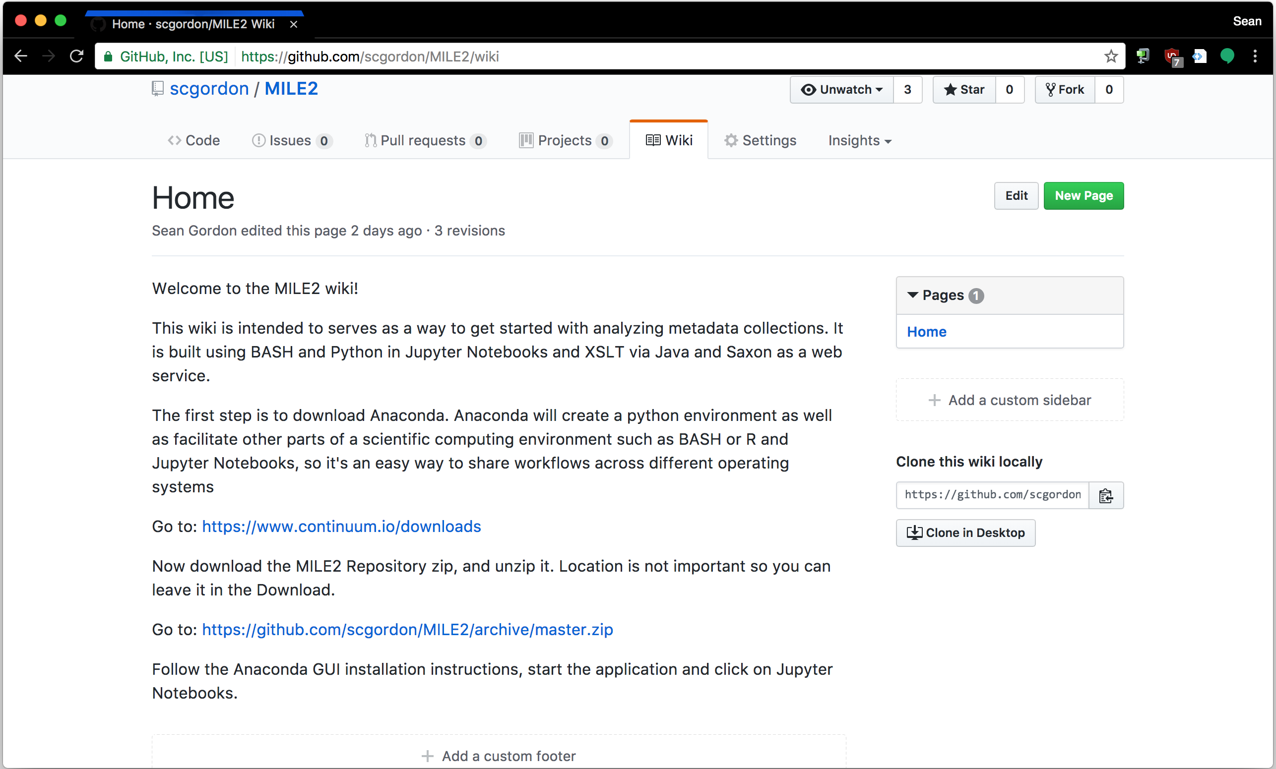
Let’s begin. Go to http://github.com/scgordon/MILE2/wiki

Slide 4
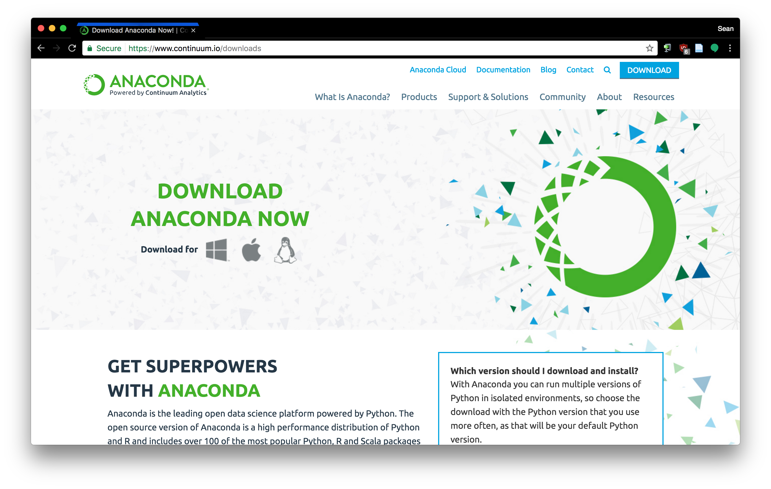
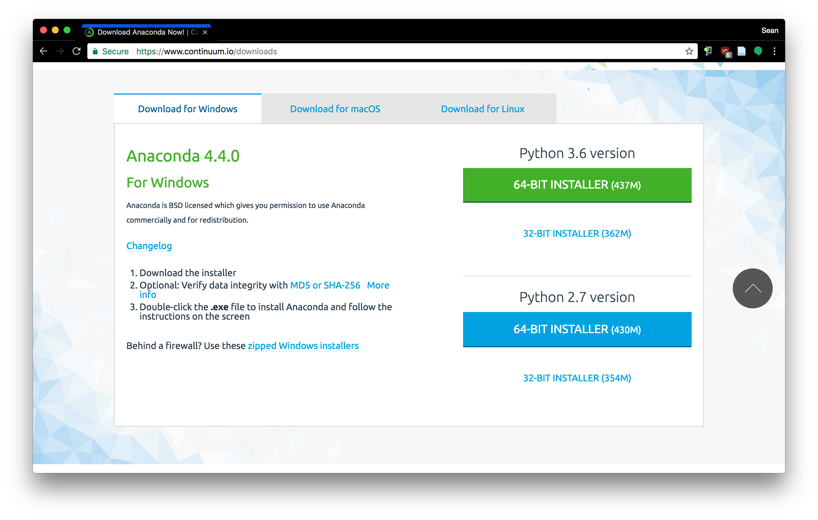
Download Anaconda with Python 3.6

Slide 5
Things We’ll Do Today
Install and use Anaconda to launch Jupyter Notebooks
Learn how to navigate a notebook
Difference between markup and code cells
While BASH and Python are used in the notebooks, this lab is not intended to teach either.
Upload metadata records to a webservice that returns the conceptual evaluation results
Explore multiple analyses that can guide improvement

Slide 6
Types of Analysis you can try today
Create Recommendations Analysis Dashboard data
Look at the content of specific concepts and identify usage patterns and inconsistencies
Identify potential dialect definitions for unknown concepts
Combine multiple results from the evaluator and compare concept frequency across collections and dialects.

Slide 7
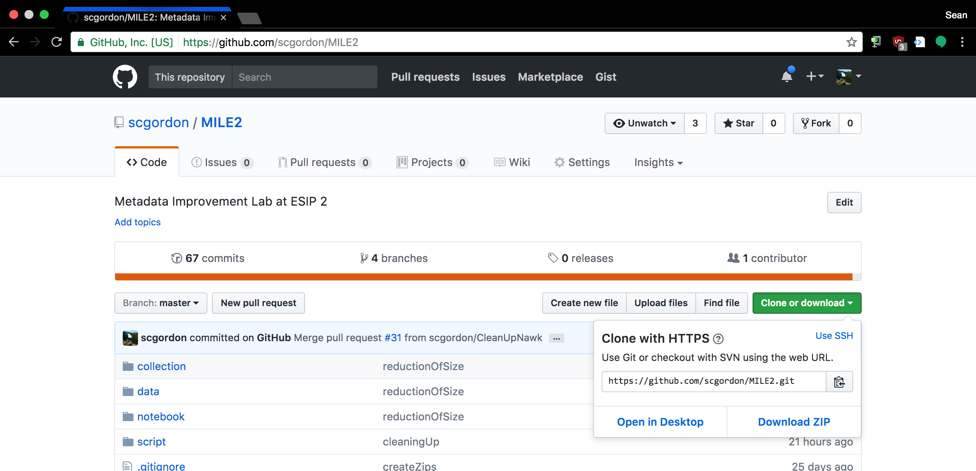
Download the MILE2 GitHub Directory
The quickest way is to download the zip file of the directory, then unzip it.
Notes:
The default download location is fine to unzip it into

Slide 8
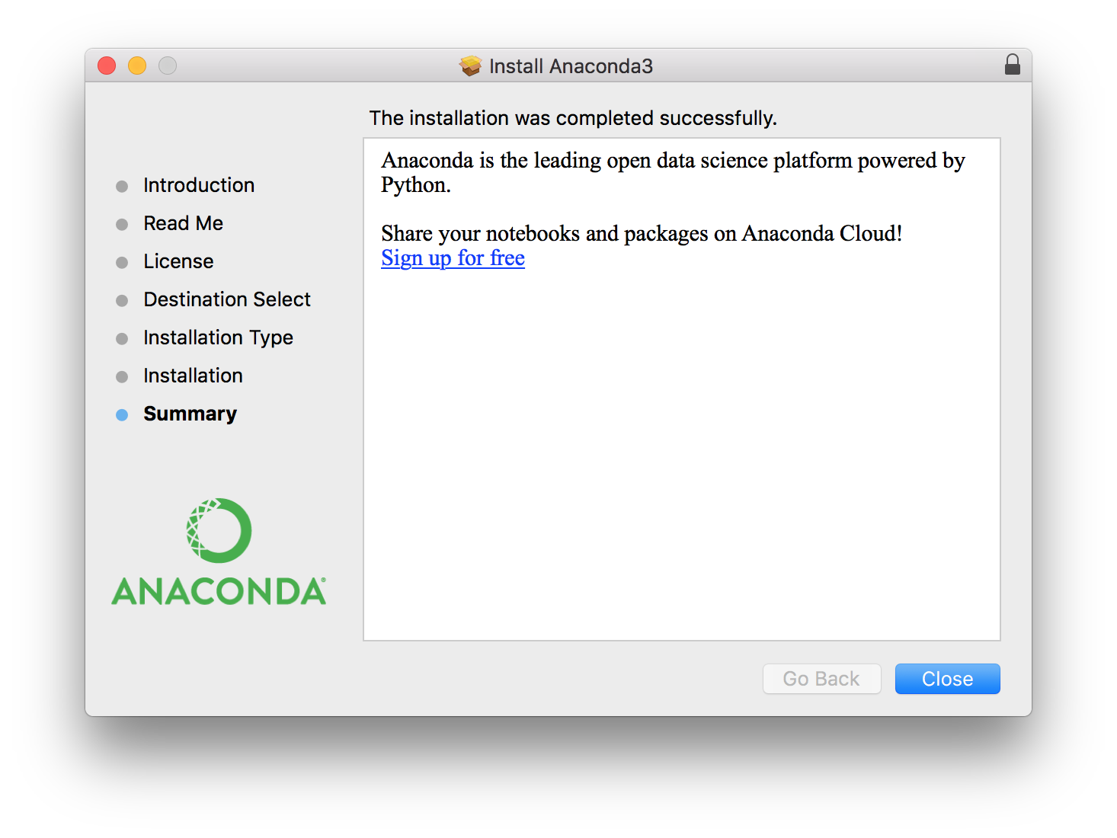
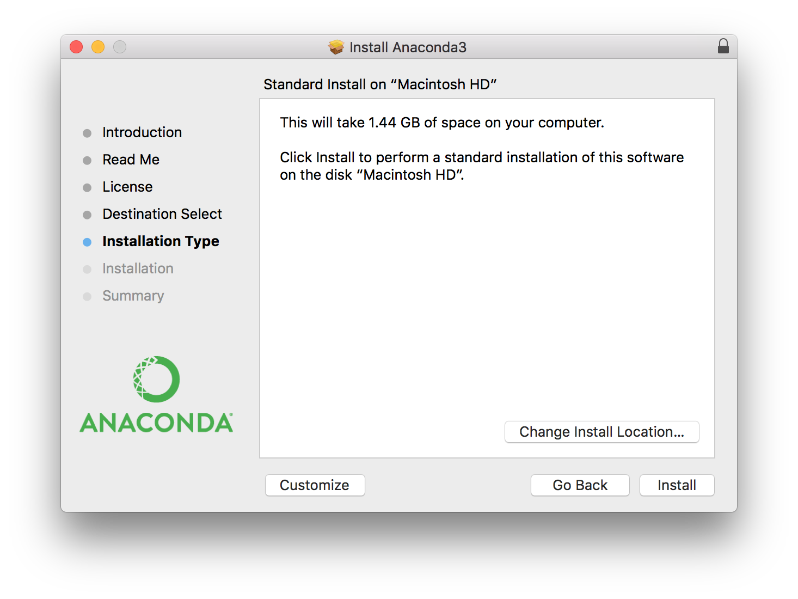
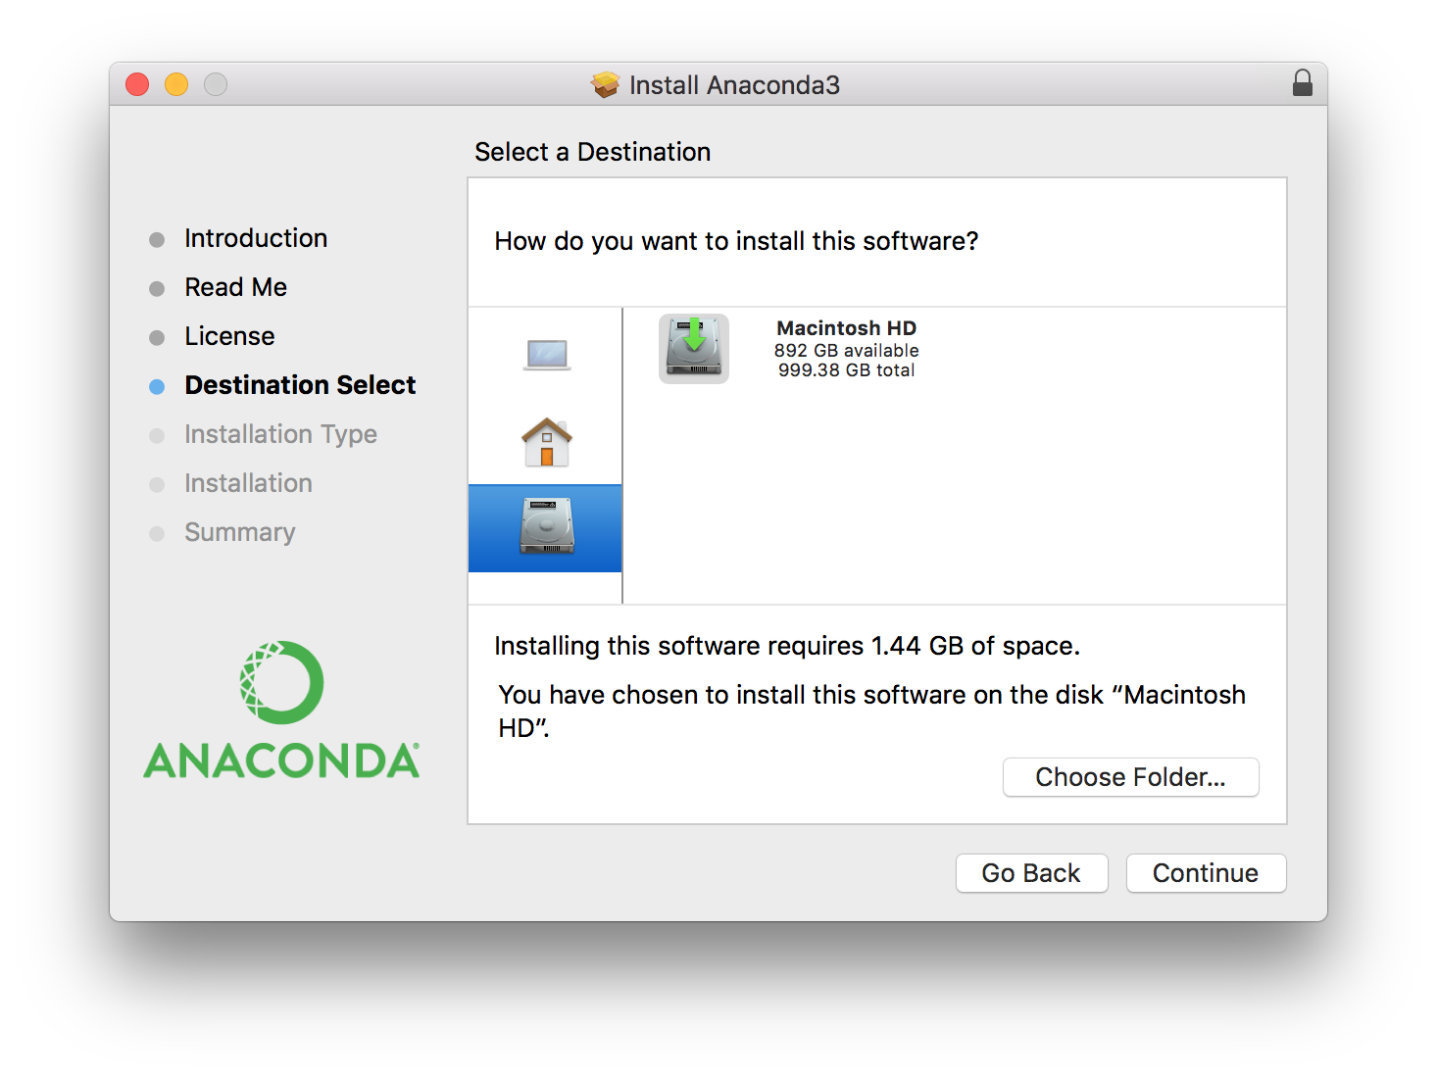
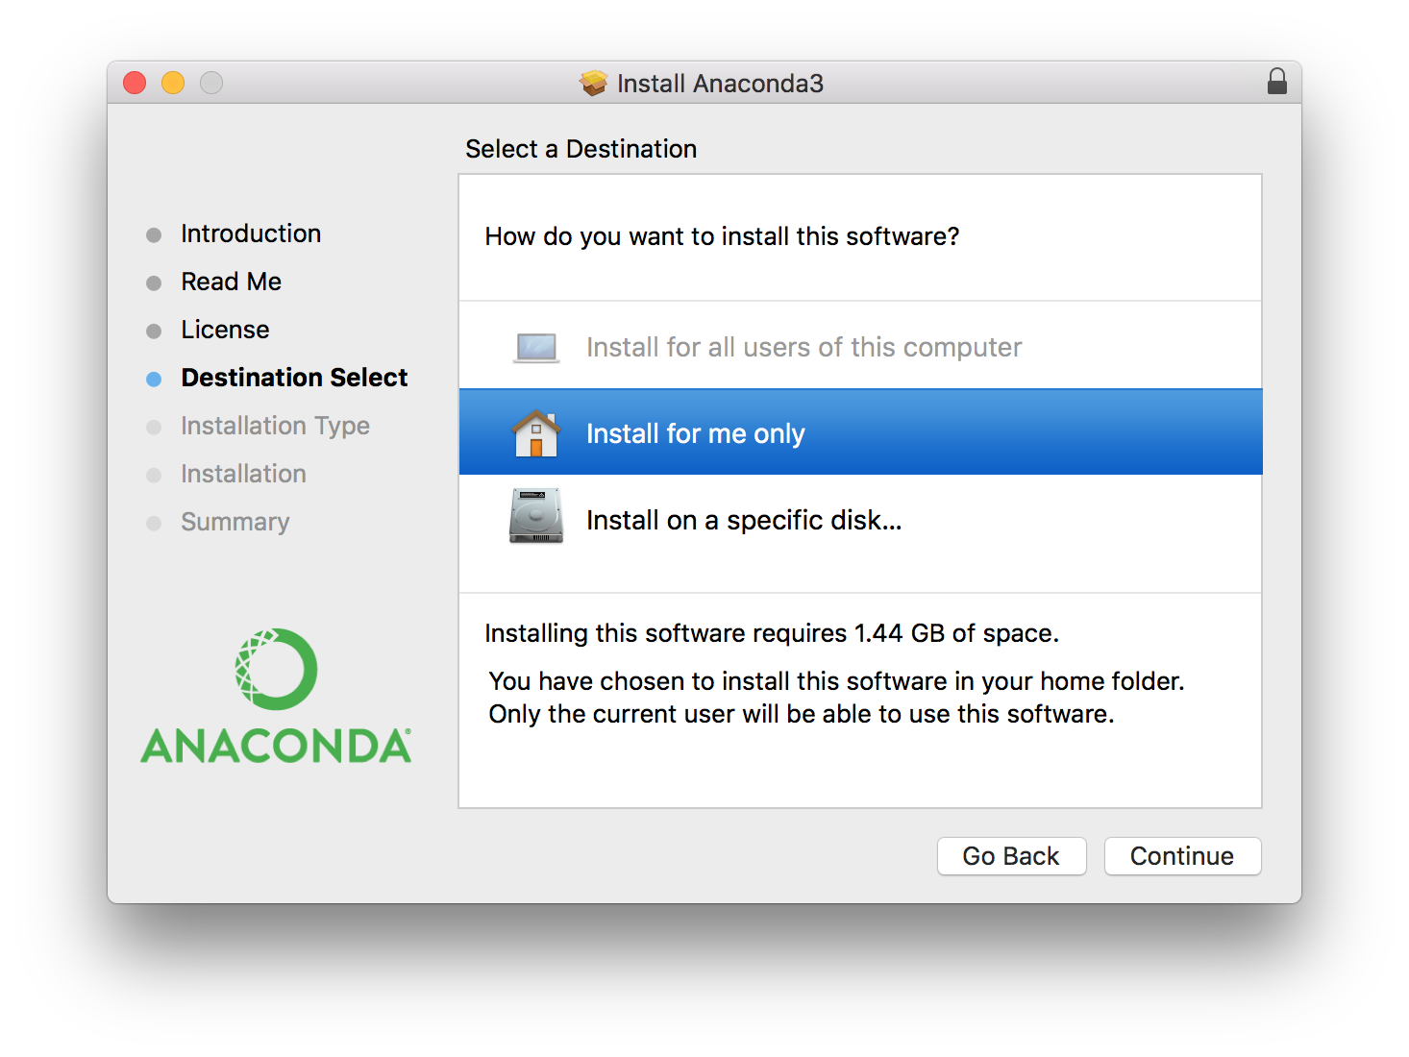
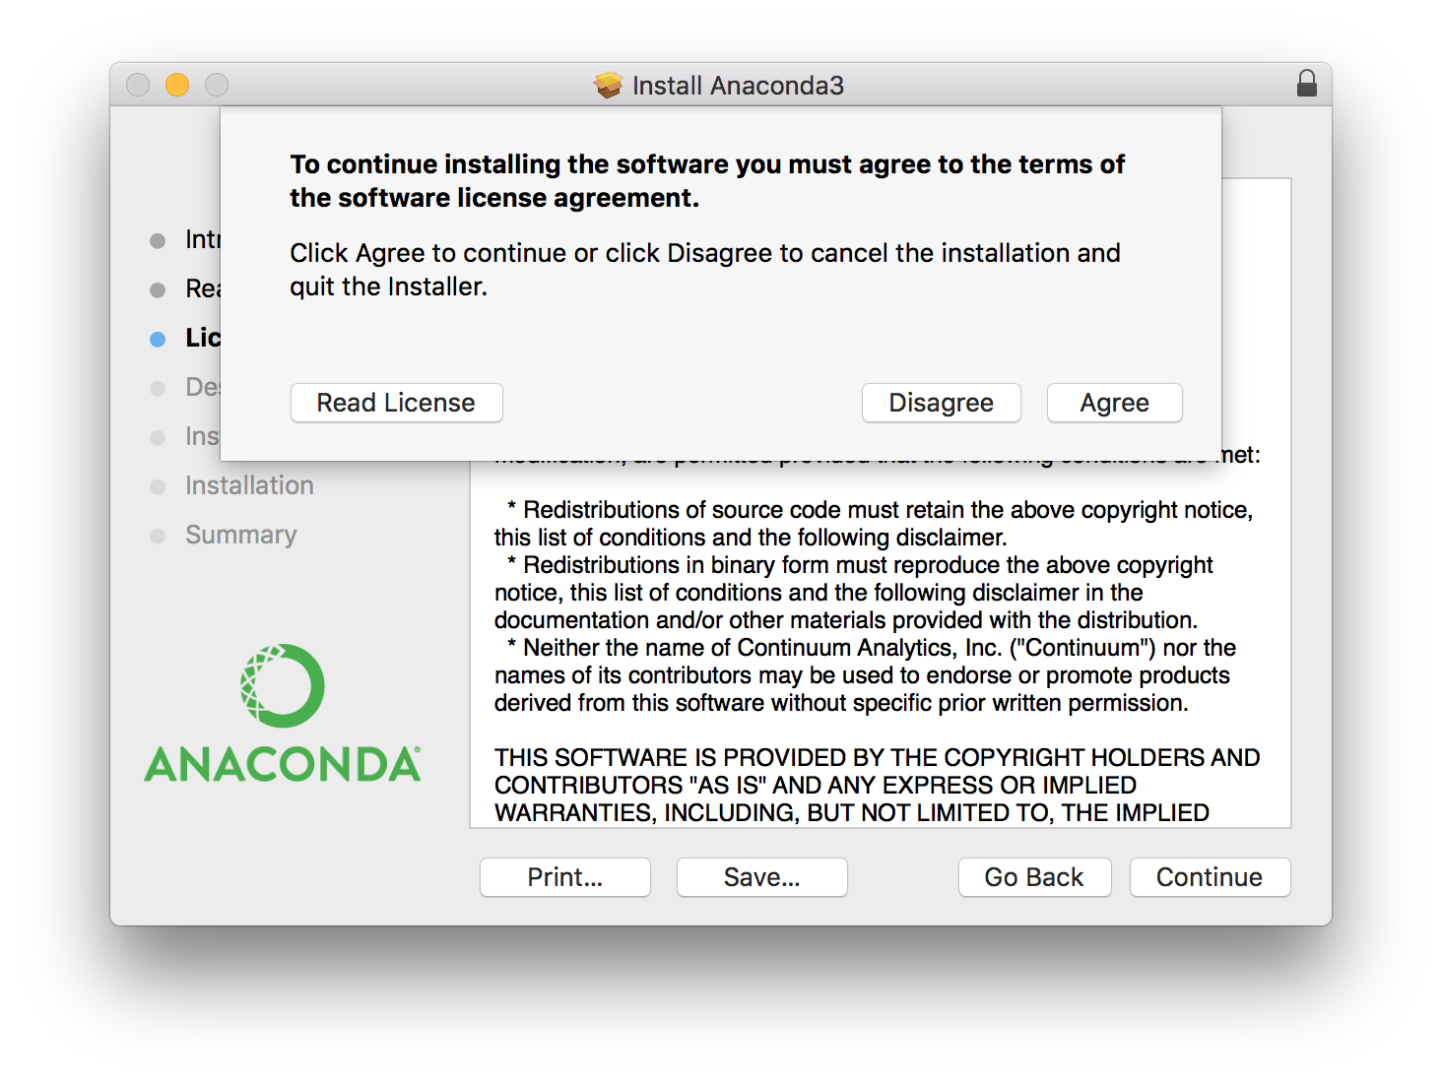
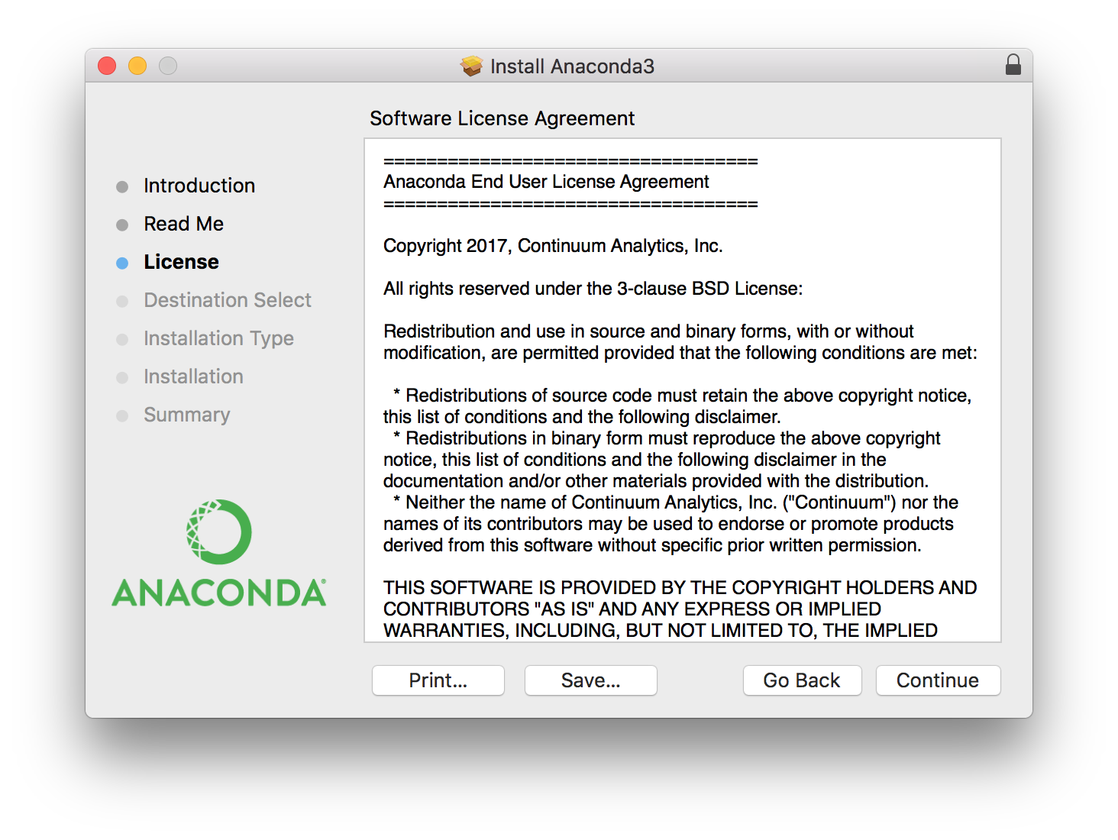
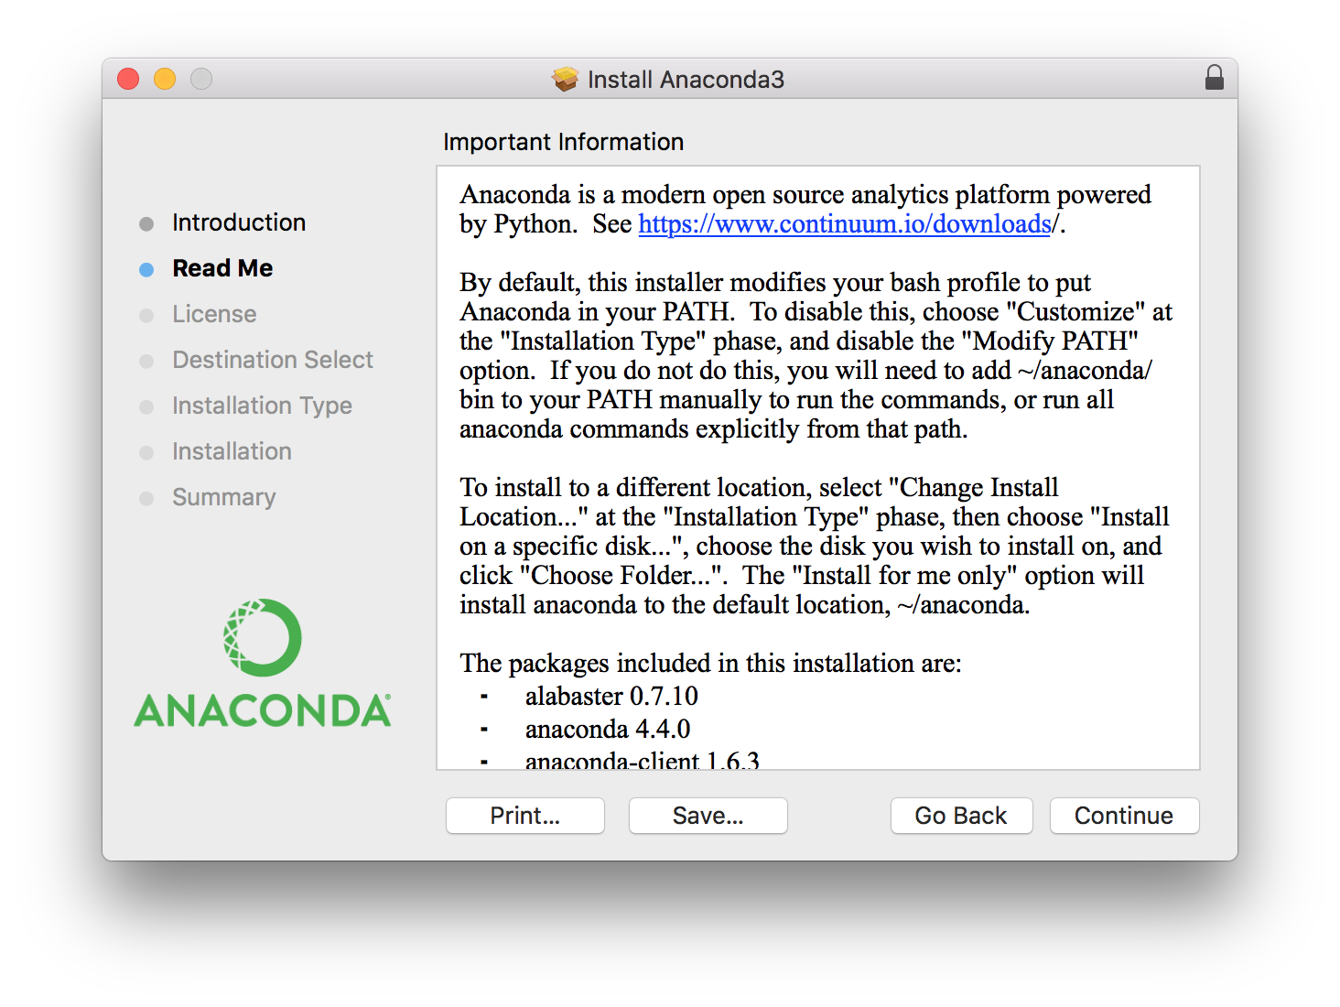
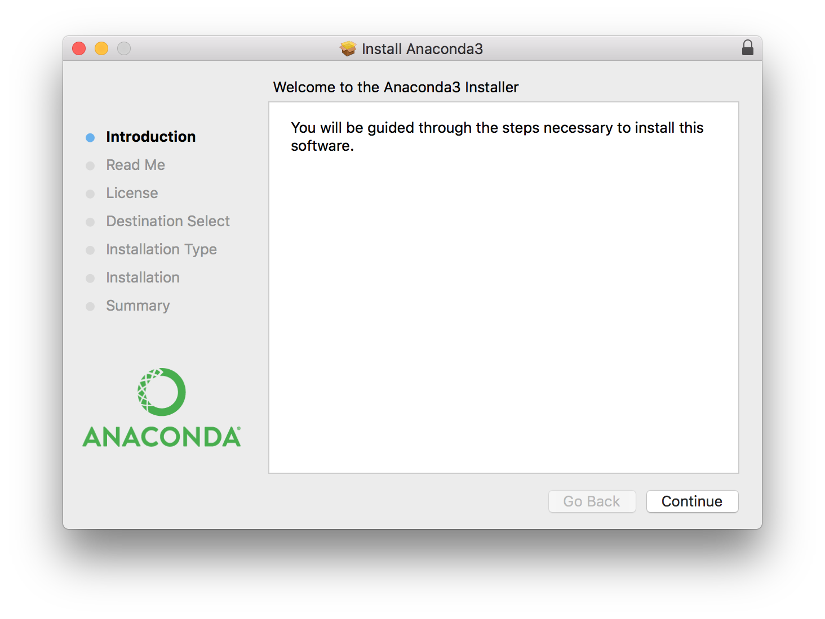
Install Anaconda with Python 3.6

Slide 9
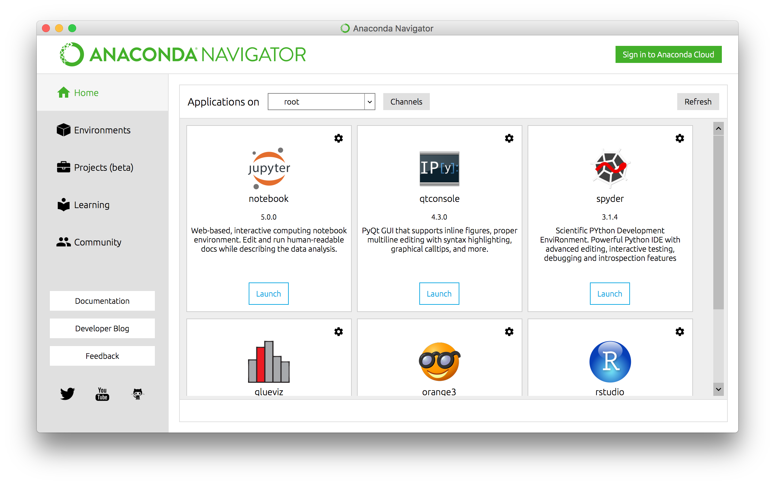
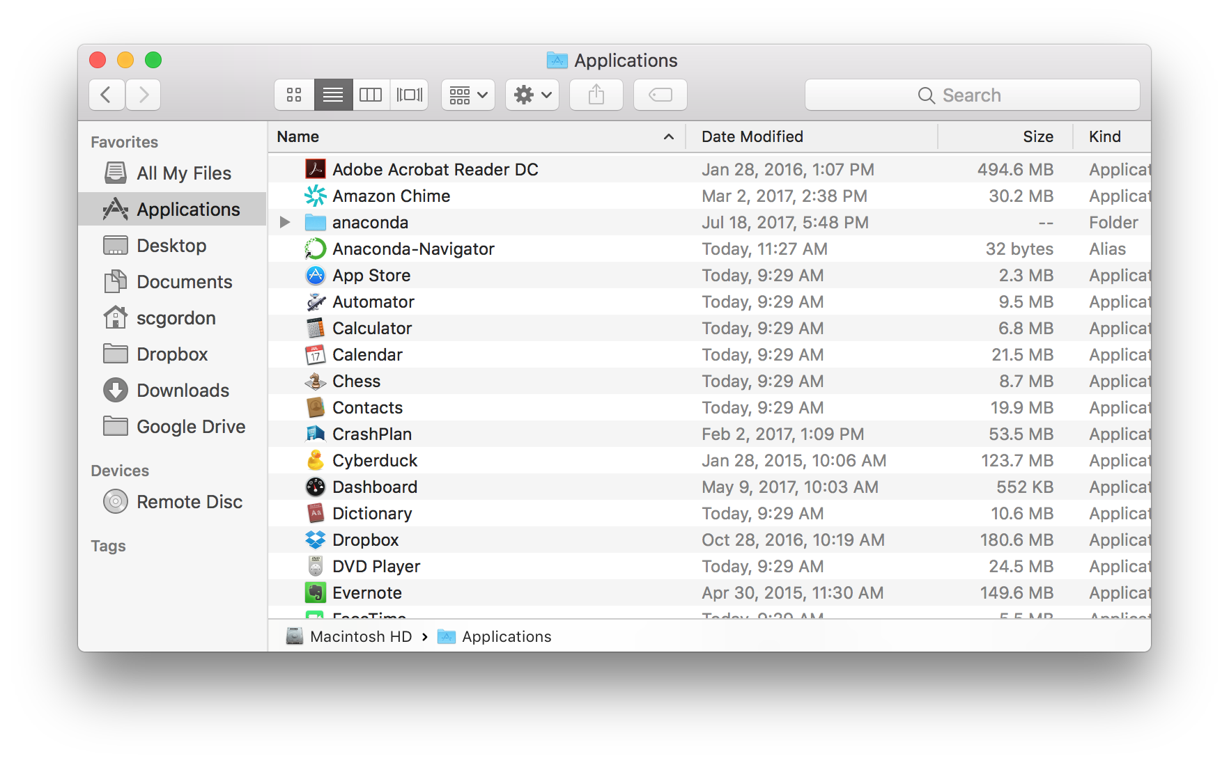
Initialize our open data scientific computing platform
Notes:
Once you’ve started Anaconda, select Jupyter Notebooks, and navigate to the MILE2 directory.

Slide 10
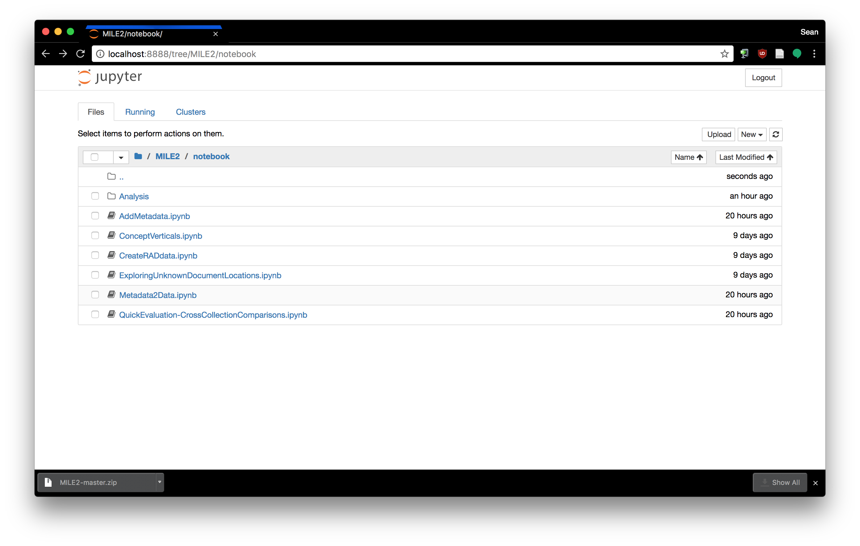
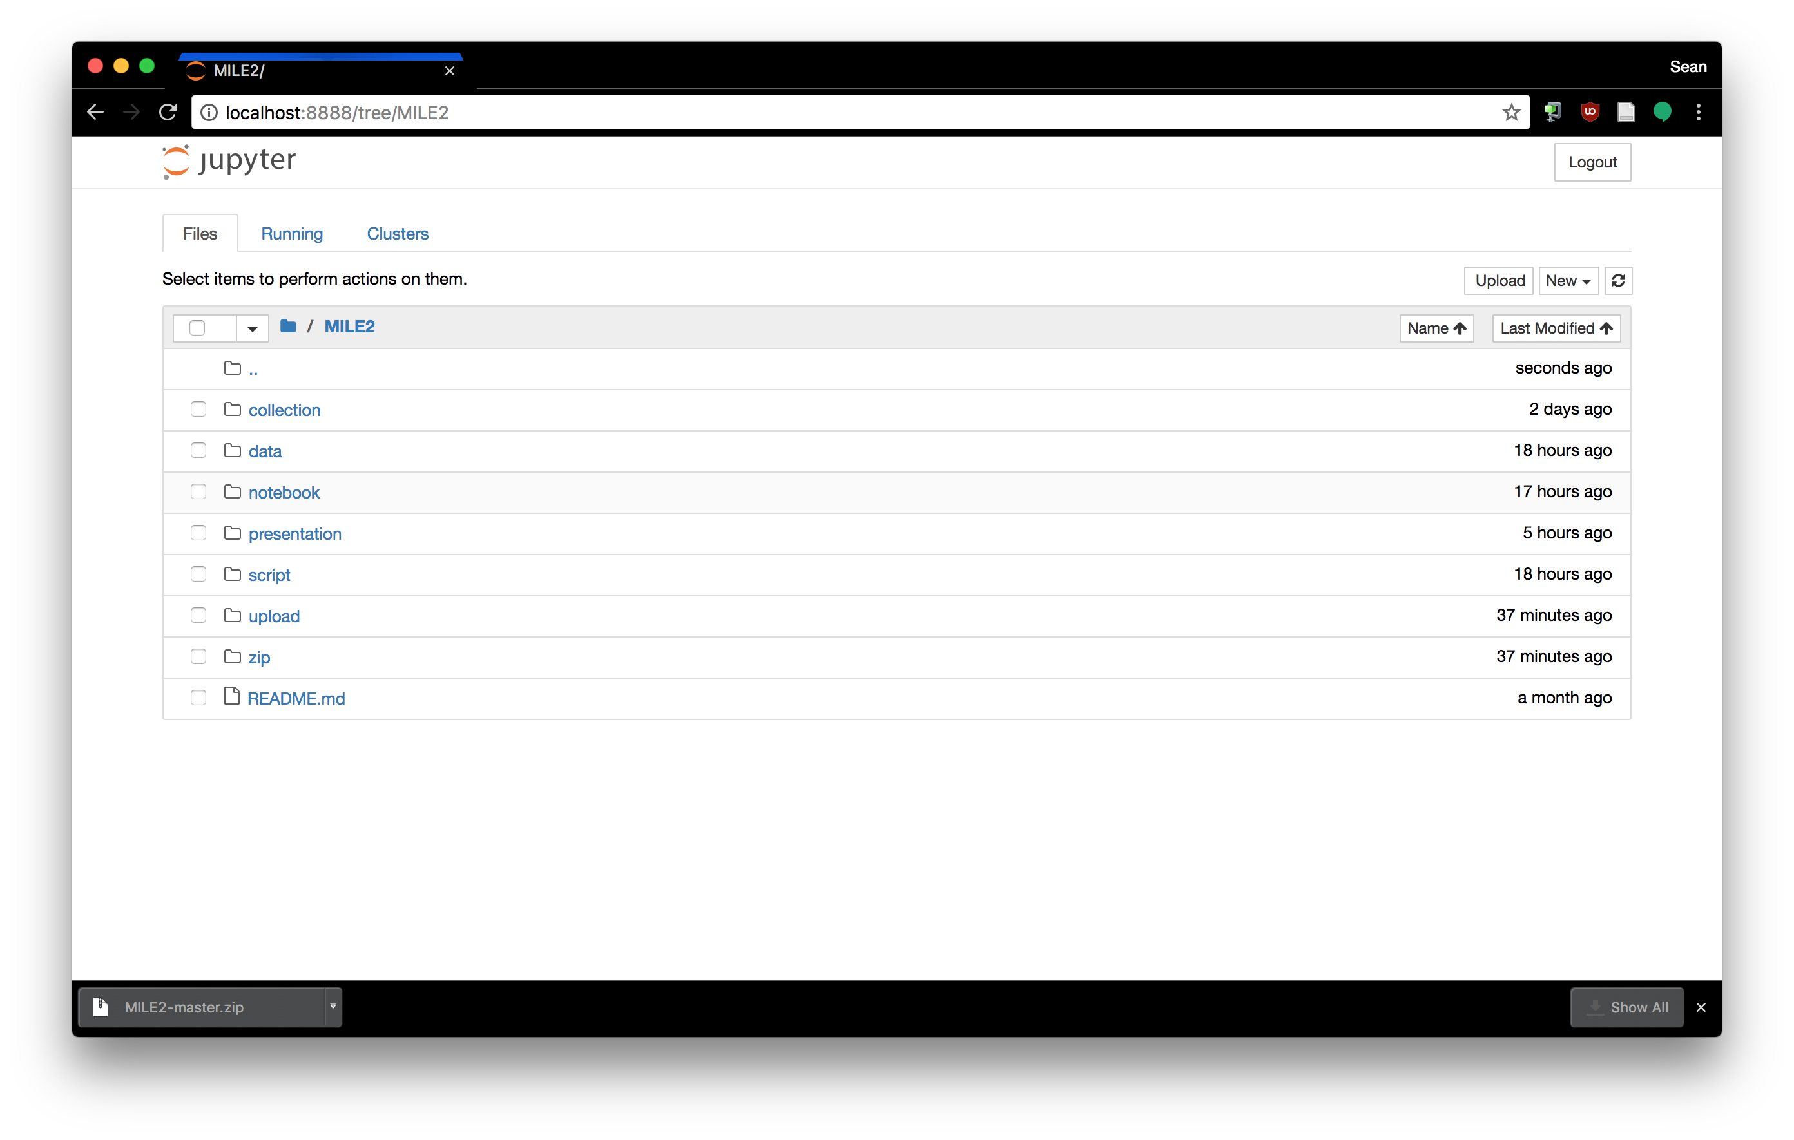
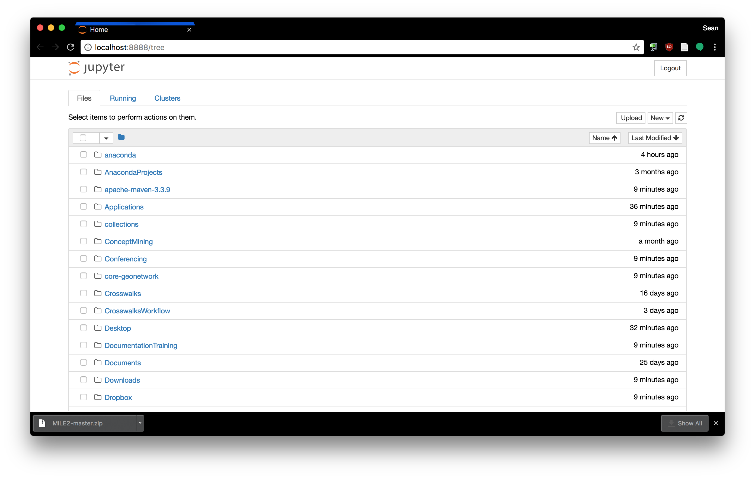
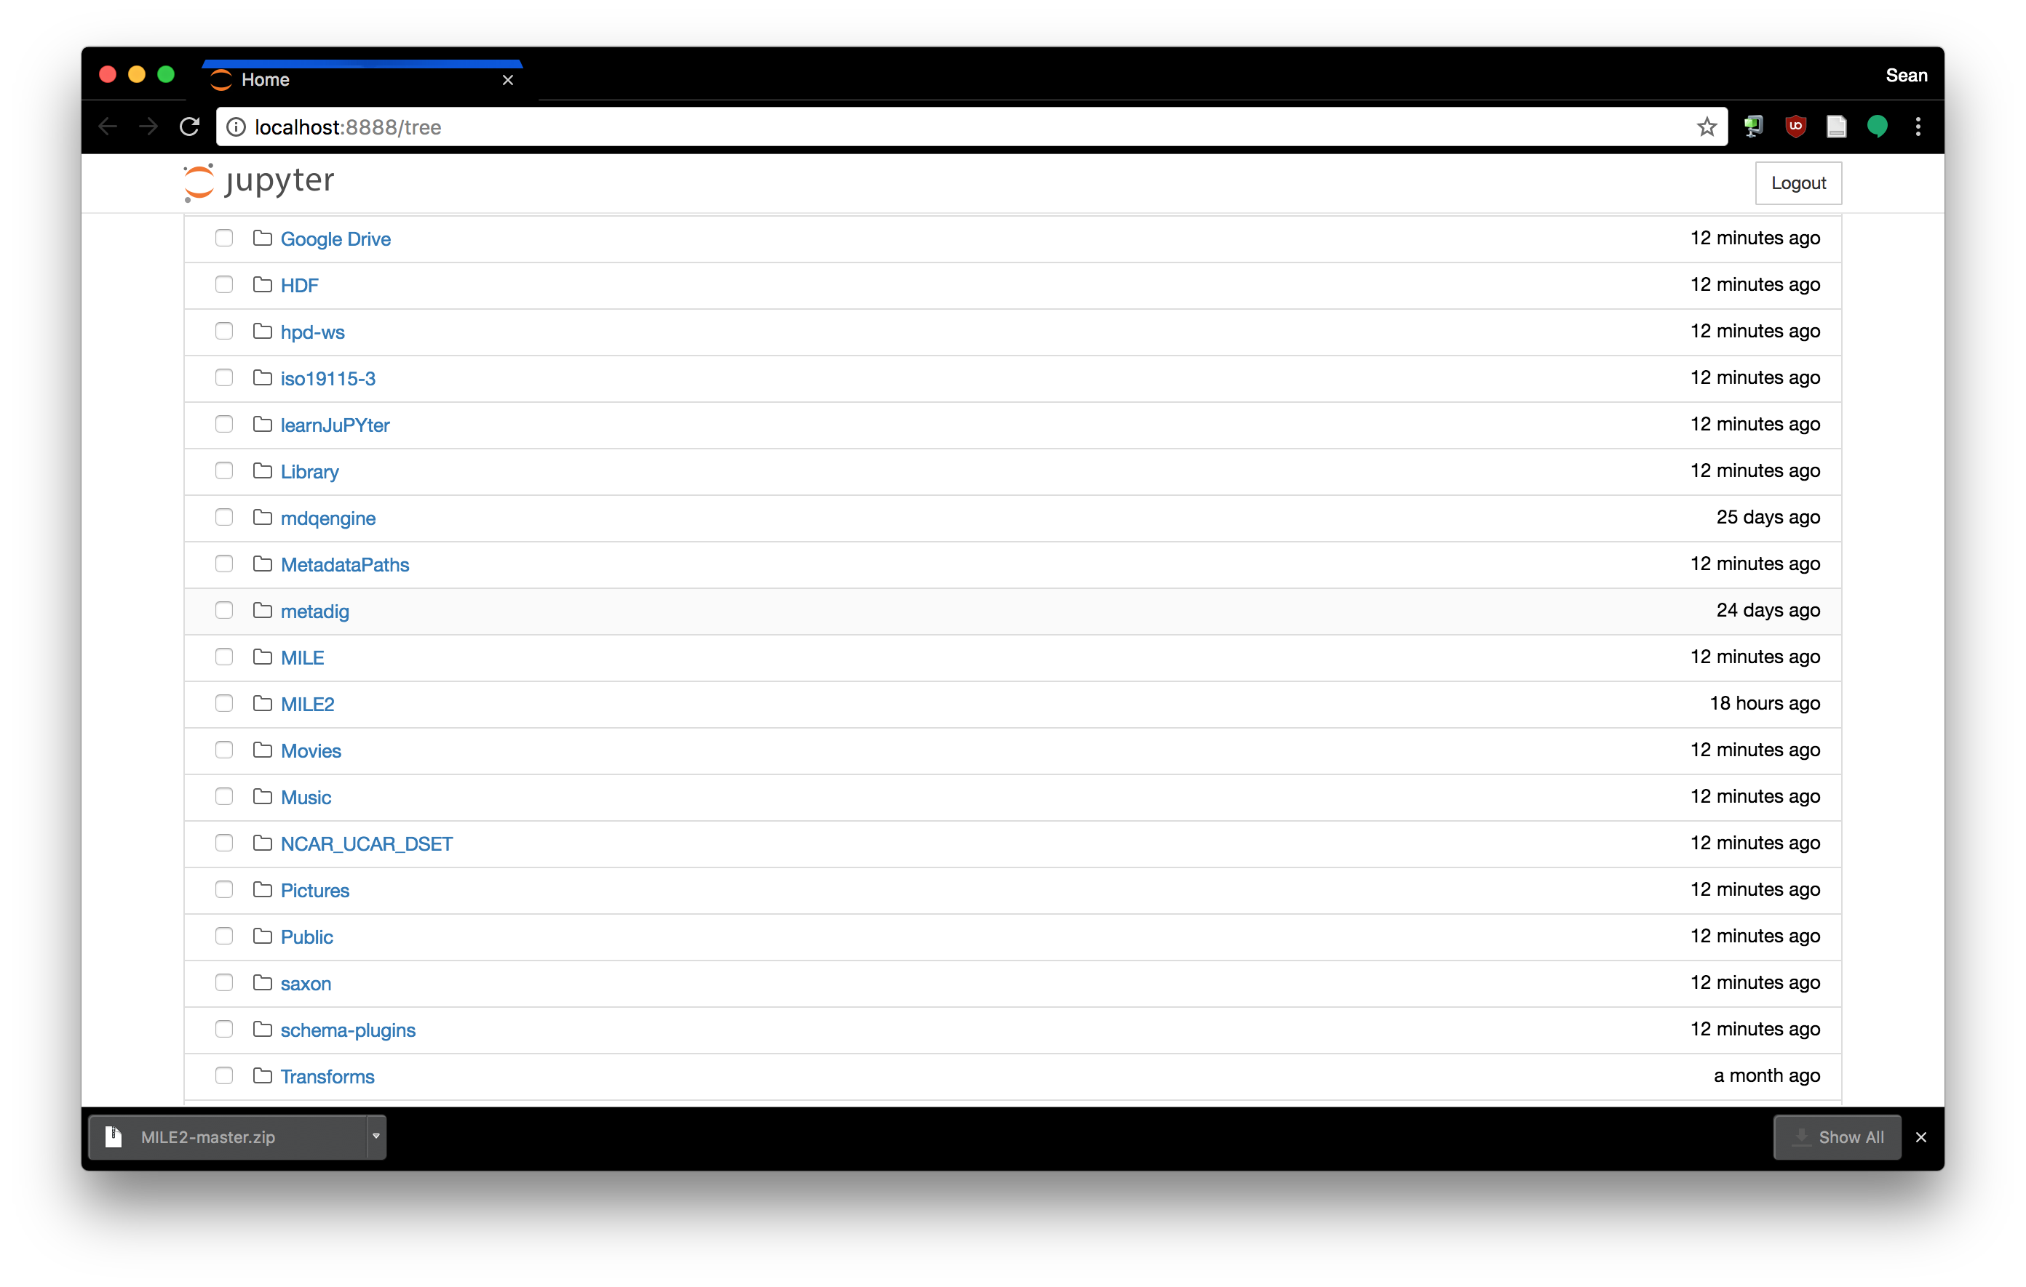
Let the evaluation begin!
Notes:
Select the MILE2 directory from where you unzipped it. The directory shown upon startup is /Users/scgordon
Select Metadata2Data.ipynb to start the notebook that prepares metadata to be bundled and uploaded to the evaluator.

Slide 11
Jupyter Notebook Navigation

Slide 12
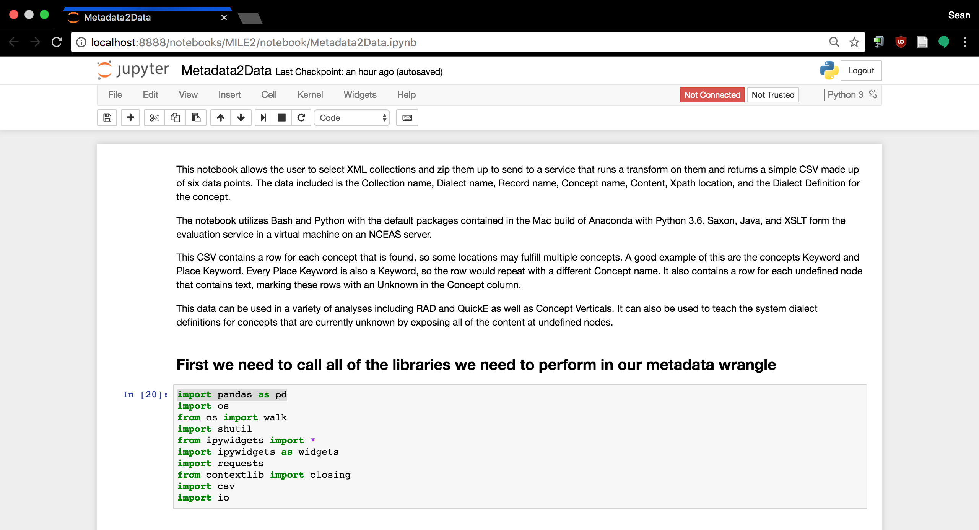
Jupyter Notebook Cells

Slide 13
A Quick Disclaimer
I am not a computer scientist.
NASA. (Unknown date). Margaret Hamilton, lead Apollo flight software engineer, in the Apollo Command Module.
Retrieved from https://commons.wikimedia.org/wiki/File:Margaret_Hamilton_in_action.jpg
Notes:
I was not trained in many of the fundamentals and styles of programming. So while for some of you this may be more technical than you are used to, others here are looking at the code like…

Slide 14
Oh, so this is a Spaghetti Western
Gefangenen, R. (2007, February 27). Blondie.
Retrieved July 18, 2017, from https://c1.staticflickr.com/1/177/403475732_65dc0af0d0_b.jpg

Slide 15
Well, get evaluating little doggies
Thanks!
scgordon@hdfgroup.org
Texas Tech University, Southwest Collection/Special Collections Library, Frank Reeves Photograph Collection, 1925-1975, FR103

Slide 16
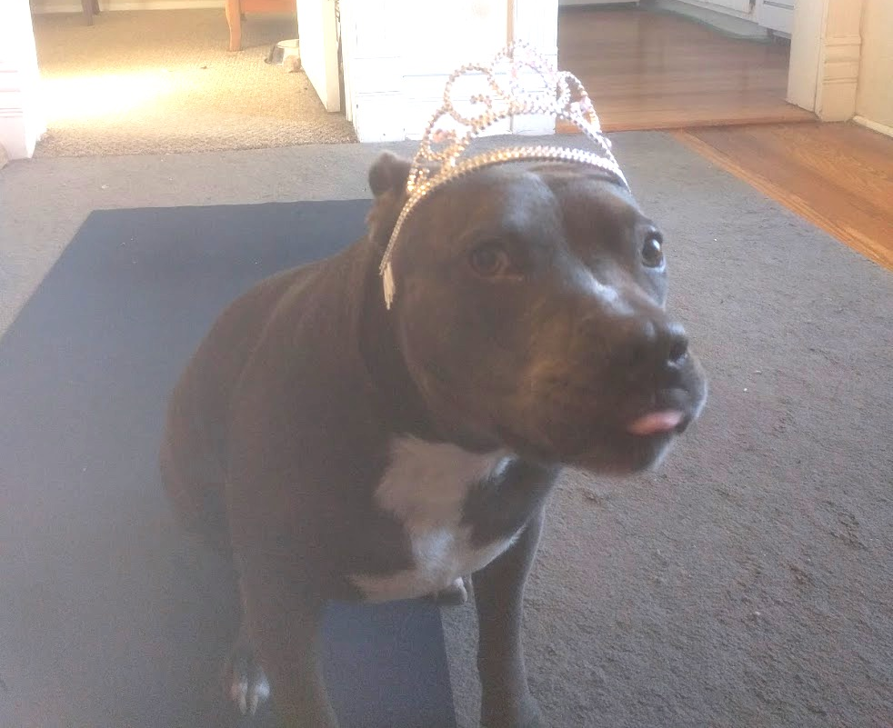
Questions?

